Slide 1


Adventure Works: Driving Growth with Data-Driven Insights
This presentation provides an executive and analyst-level overview of Adventure Works' performance, leveraging detailed Power BI dashboard analysis. We will explore key revenue drivers, customer behavior, product performance, and regional contributions to inform strategic decisions.
-Dhiman Chakraborty

Slide 2
Adventure Works: Project Summary
📊 Adventure Works Sales Dashboard – Project Summary
🔹 Project Objective
The objective of this project was to design an interactive Power BI dashboard to analyze sales performance, customer behavior, product trends, and regional profitability, enabling management to make data-driven strategic decisions.
🔹 Tools & Technologies Used
Power BI – Data modeling, DAX, interactive dashboards
Power Query – Data cleaning and transformation
DAX – Measures for revenue, profit, growth, KPIs
Adventure Works Dataset – Sales, customers, products, geography
🔹 Key Business Metrics Tracked
Total Revenue
Total Profit & Profit Margin
Cost of Goods Sold (COGS)
Total Orders & Returned Orders
Customer Count & Purchase Power
Stock Clearance Rate
Year-to-Date (YTD), Month-to-Date (MTD), and YoY Growth

Slide 3
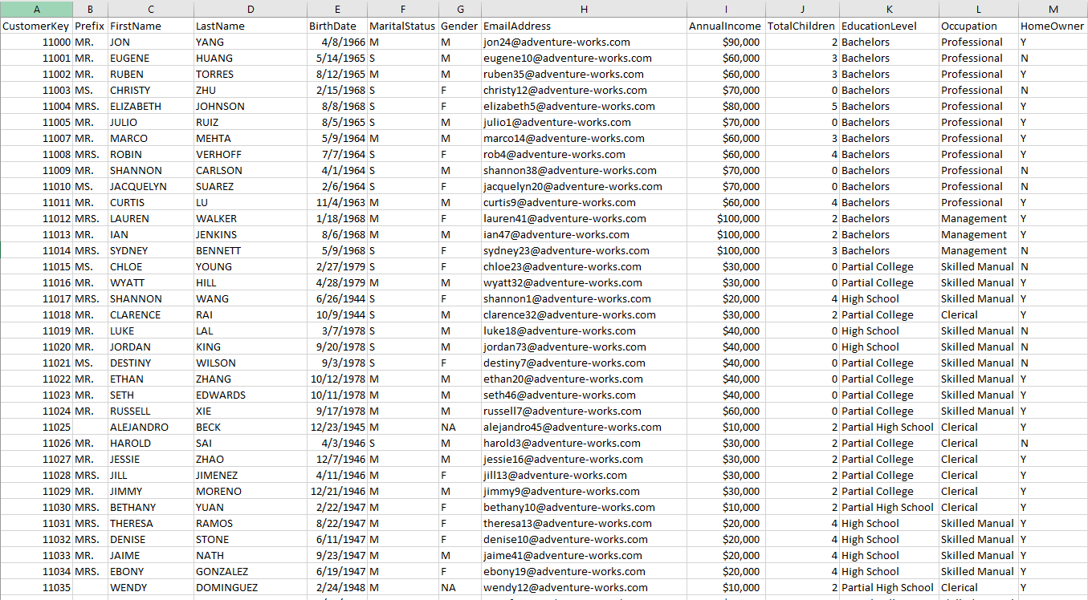
Datasets: Customer Table

Slide 4
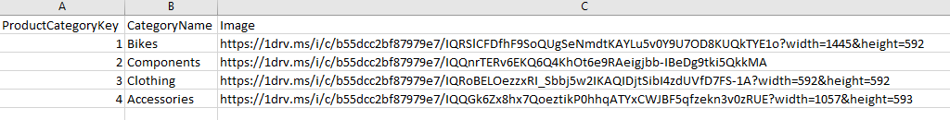
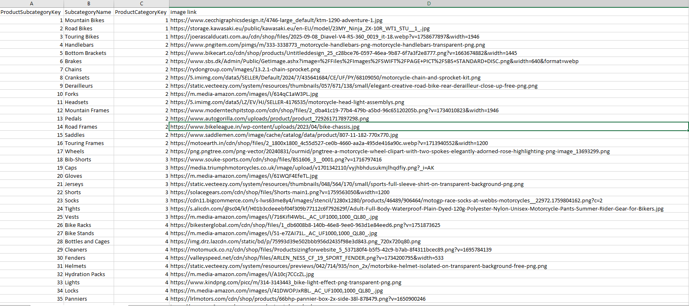
Datasets: Product Category Table
Datasets: Product Sub-Category Table

Slide 5
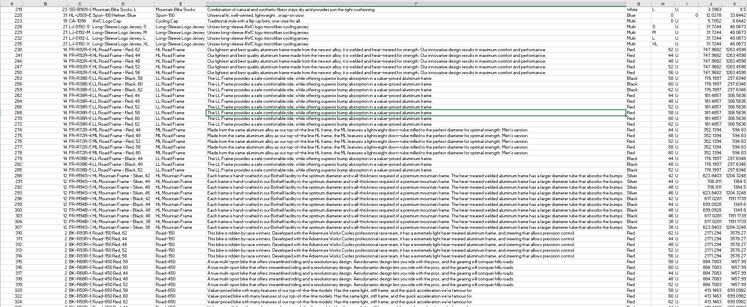
Datasets: Product Table

Slide 6
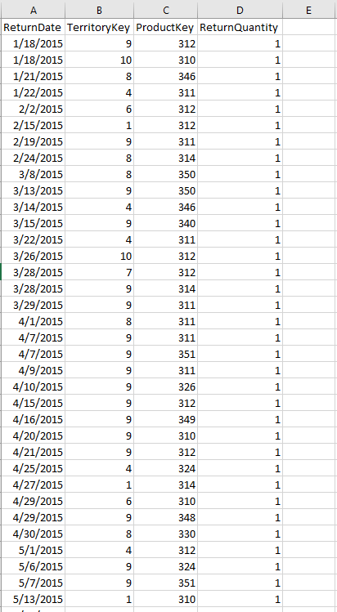
Datasets: Order Return Table

Slide 7
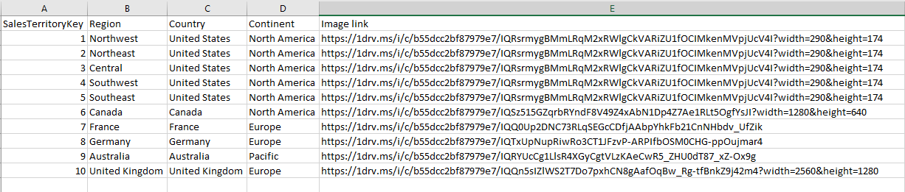
Datasets: Territory Table

Slide 8
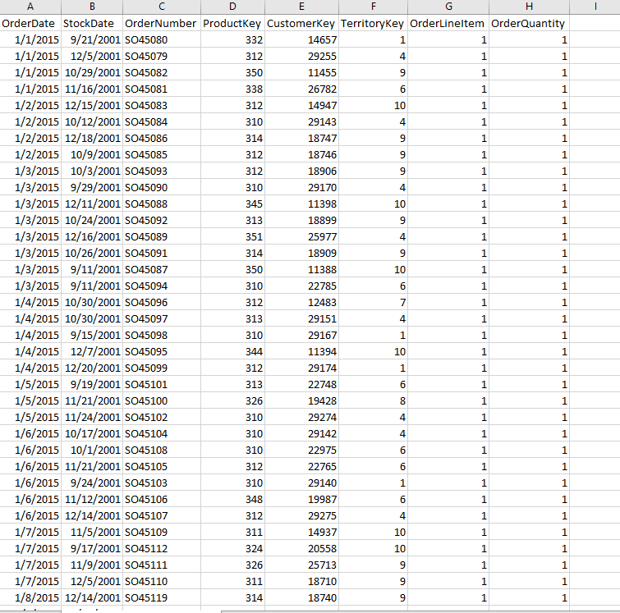
Datasets: Orders Table

Slide 9


Slide 10
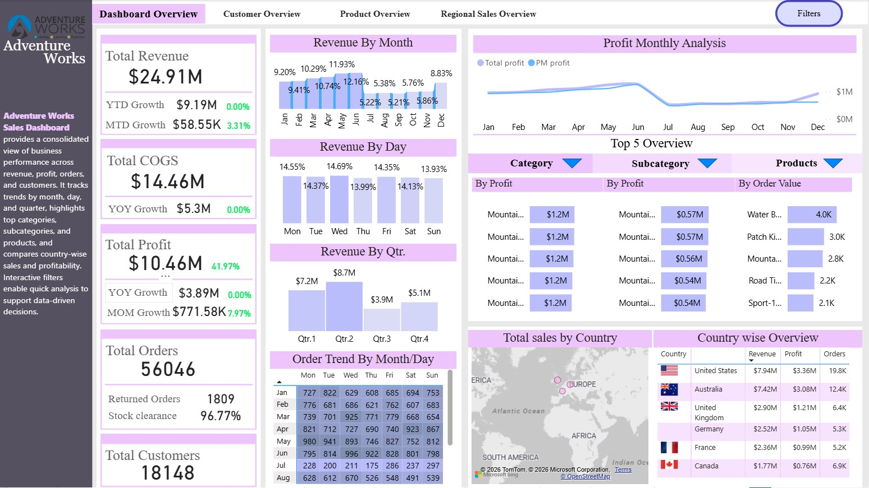
Dashboard: Overview

Slide 11
Dashboard Overview: Executive Summary
A high-level snapshot of overall business performance, highlighting key financial metrics, operational efficiency, and market insights to drive strategic decisions.
$24.91M
$10.46M
$14.46M
56,046
Total Revenue
Total Profit
Total COGS
Total Orders
Strong top-line performance across
all product lines.
Achieving a healthy ~42% profit
margin, indicating efficient operations.
Cost of Goods Sold managed
effectively relative to revenue.
Consistent order volume
demonstrating strong customer demand.
18,148
96.8%
Total Customers
Stock Clearance
A growing customer base, indicating
successful market penetration.
High efficiency in inventory
management and sales velocity.

Slide 12

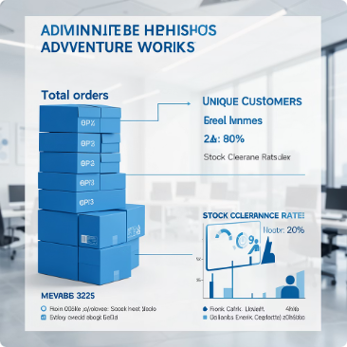
Dashboard Overview: Executive Summary
Financial Health at a Glance
Operational Scale & Efficiency
Adventure Works demonstrates strong overall financial performance. Total Revenue stands at $24.91M, yielding a robust $10.46M in Total Profit, which translates to an impressive ~42% margin. Our Cost of Goods Sold (COGS) is managed at $14.46M, ensuring healthy profitability.
With 56,046 Total Orders and a customer base of 18,148 unique individuals, Adventure Works operates at a significant scale. Our Stock Clearance Rate, at approximately 96.8%, indicates efficient inventory management and minimal obsolescence.
This high-level snapshot confirms a strong operational foundation with excellent profitability metrics, setting the stage for deeper analysis into specific performance areas.

Slide 13
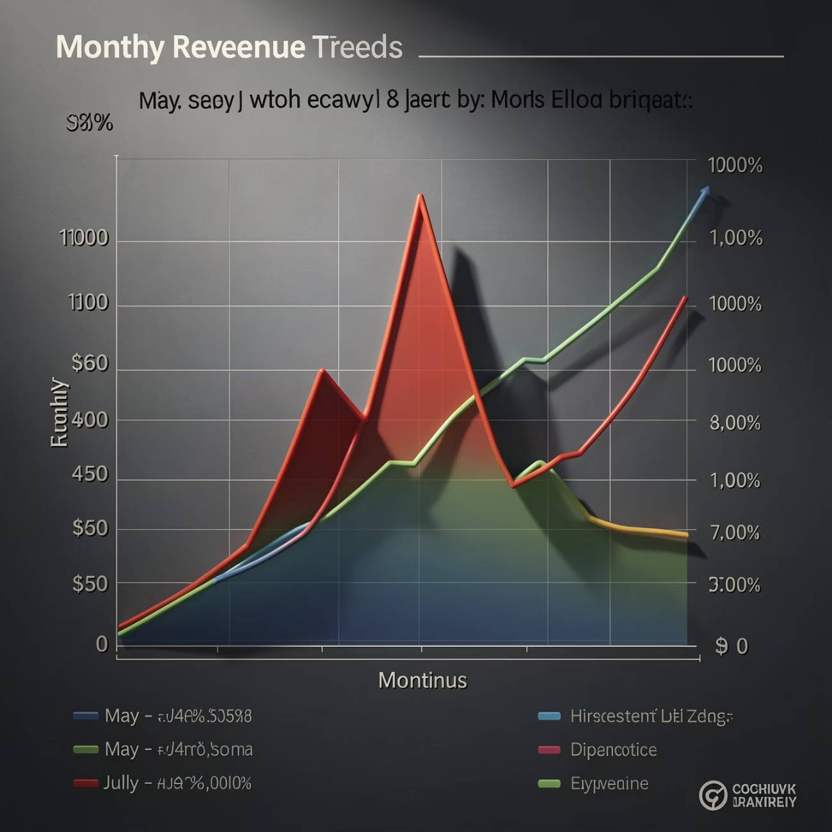
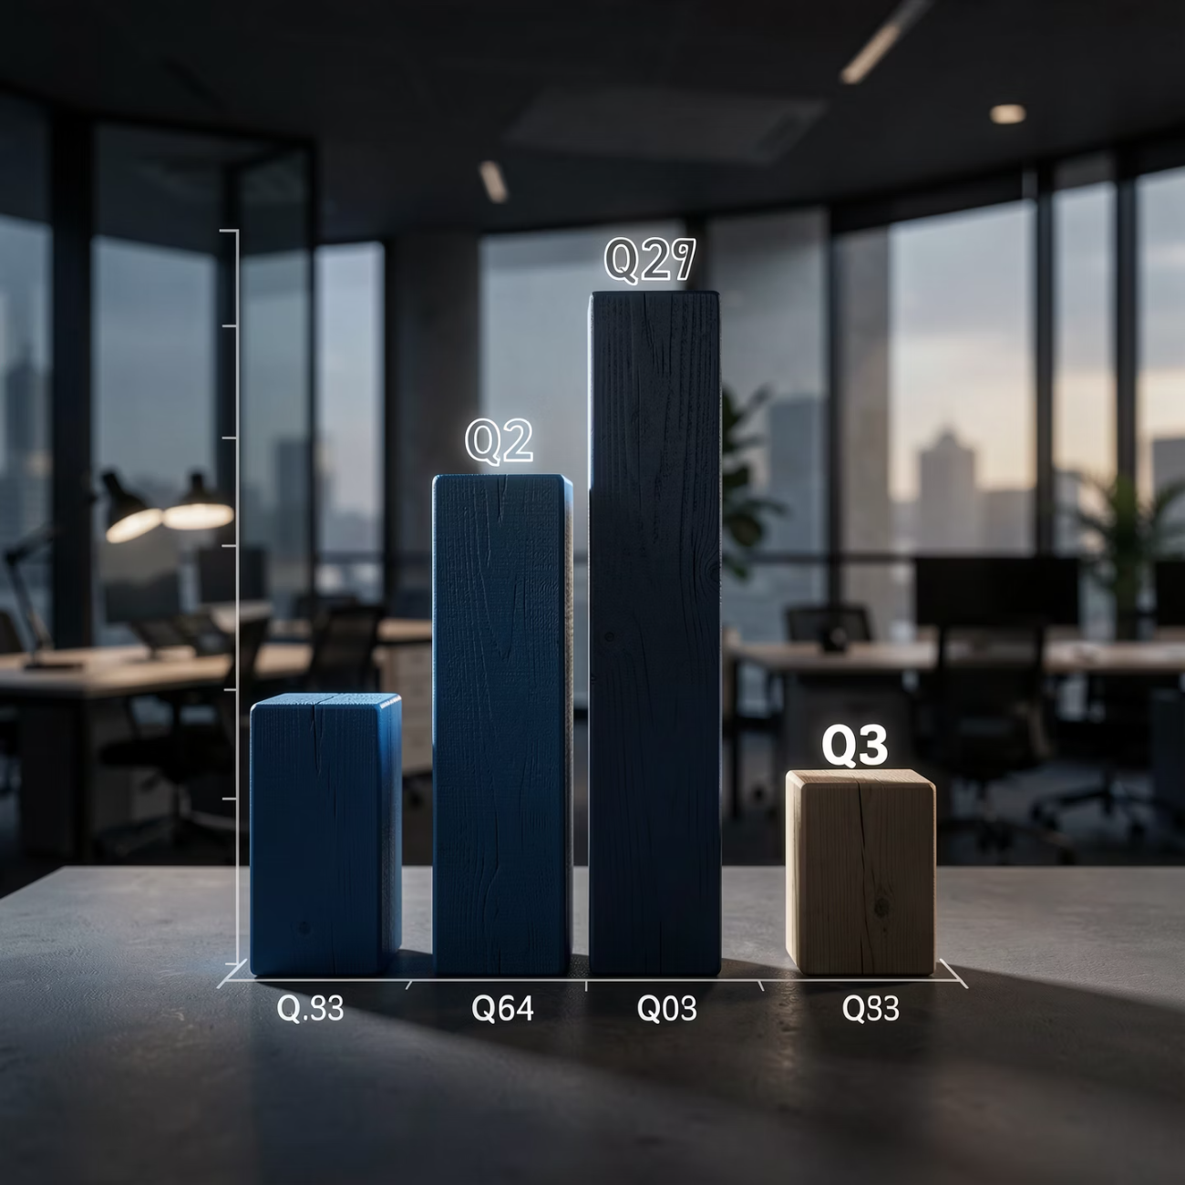
Revenue Trends & Seasonal Patterns
Monthly Revenue Peaks & Dips
Quarterly Performance & Seasonality
Our monthly revenue analysis reveals consistent patterns. We observe significant peaks around May–June, indicative of strong seasonal demand. A subsequent dip occurs in July, followed by a steady recovery that extends through to December. Understanding these monthly fluctuations is crucial for effective resource allocation and marketing efforts.
Aggregating data quarterly, Q2 consistently emerges as our strongest period for revenue generation. Conversely, Q3 is identified as the weakest quarter, highlighting clear and predictable seasonality within our business model. The profit trend closely mirrors revenue, suggesting a stable cost structure relative to sales volume.
This seasonality presents opportunities for strategic demand planning and targeted campaigns to mitigate dips and maximize peak performance. Strong profitability across these trends confirms a healthy underlying business.

Slide 14
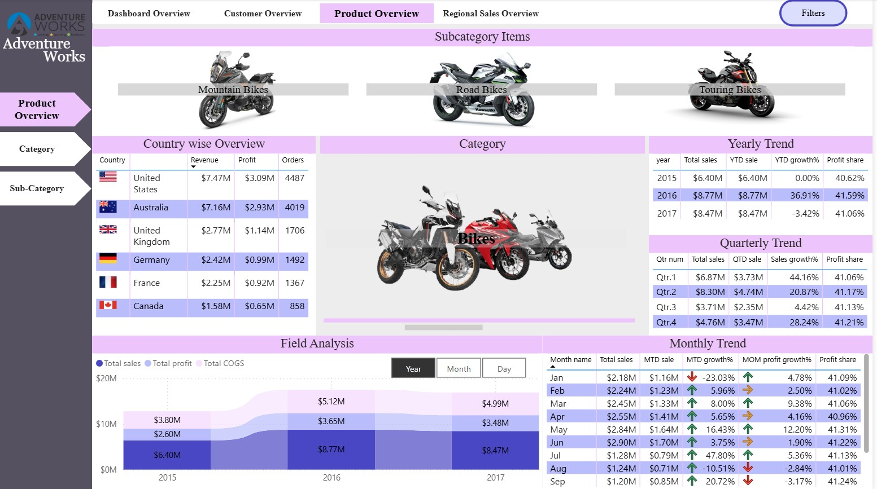
Dashboard: Product Overview

Slide 15
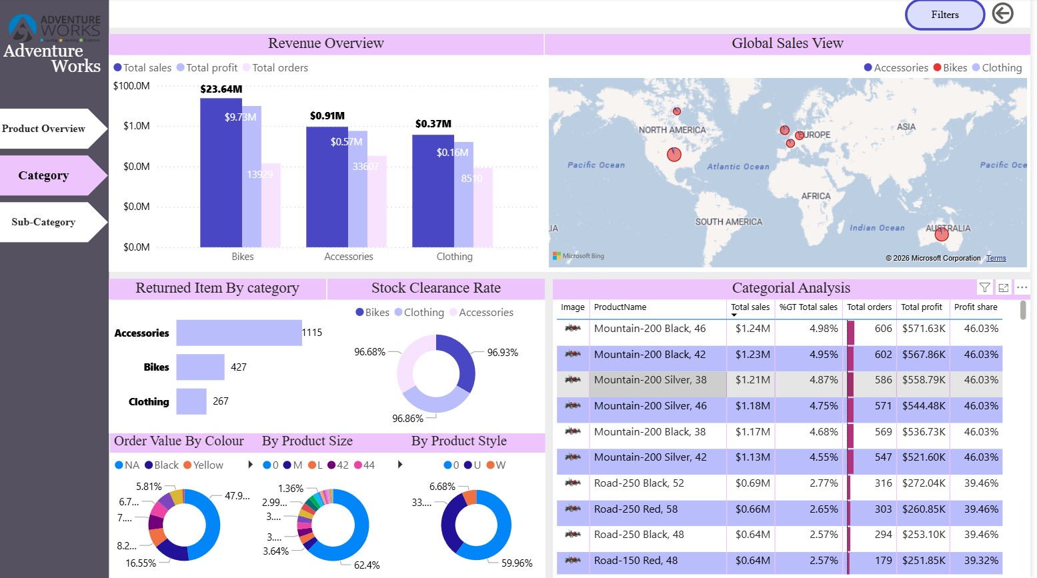
Dashboard: Product Category Overview

Slide 16






Product Overview: Category Level Performance
This dashboard provides a detailed breakdown of revenue, profit, and operational metrics across our core product categories: Bikes, Accessories, and Clothing.
Bikes: Strategic Driver
Accessories: Margin Booster
Clothing: Support Category
Generating ~$23.6M in revenue and ~$9.7M in profit, Bikes are our primary growth engine. Sustained investment and innovation in this category are crucial.
Accessories offer moderate revenue with healthy margins. However, they show the highest return volume, indicating a need for quality control improvements.
Clothing is currently our lowest contributor in both revenue and profit. It serves as a complementary category, enhancing the overall customer experience.
Efficient Inventory
Our overall stock clearance rate of ~97% demonstrates highly efficient inventory management across all product categories.

Slide 17
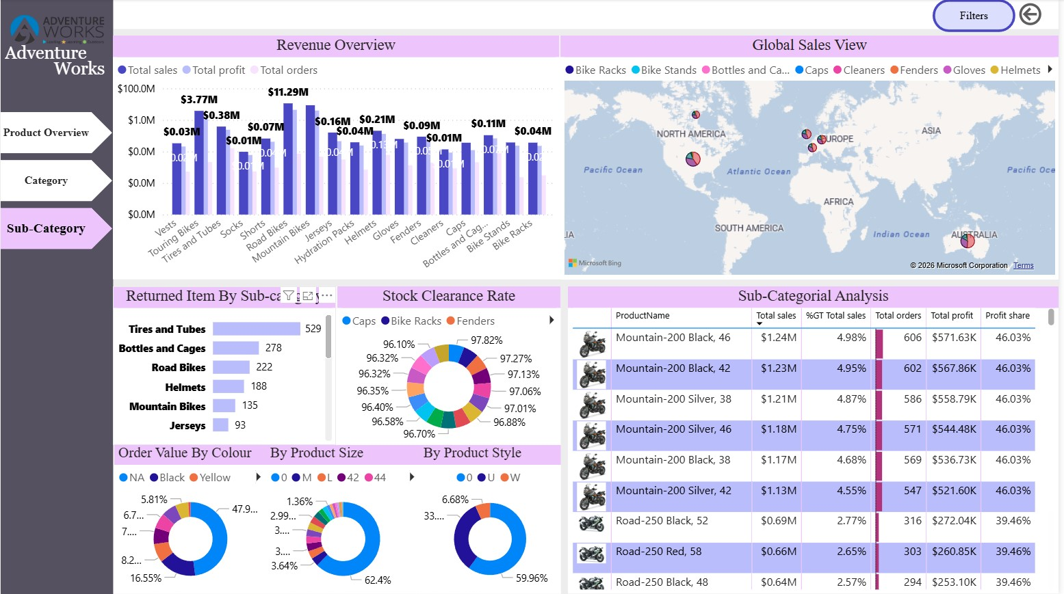
Dashboard: Product Sub-Category Overview

Slide 18
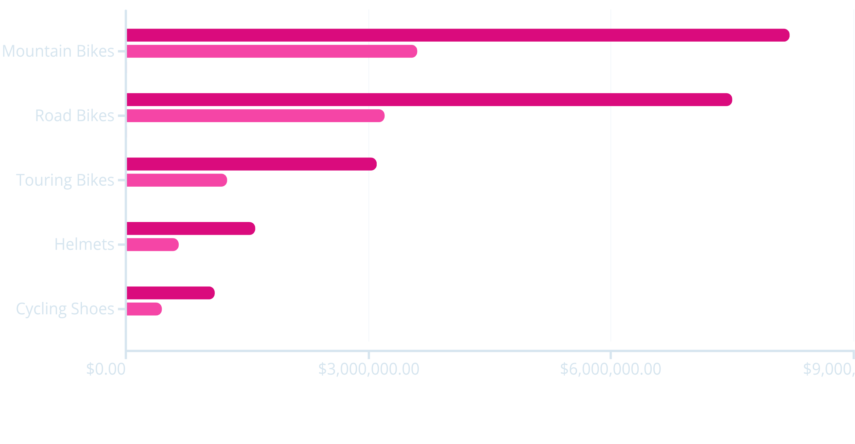
Product Overview: Sub-Category Level
Delving deeper into product performance, this analysis provides a granular view of revenue, profit, and order volumes across specific product sub-categories, highlighting our top-performing "hero products."
Revenue
Profit
Orders
Hero Products Drive Revenue: Mountain Bikes and Road Bikes are clear leaders, contributing significantly to overall revenue and profit.
Consistent Profit Margins: Profit margins remain stable across these top-performing SKUs, indicating healthy unit economics.
SKU-Level Optimization: Focusing on the distinct characteristics and customer segments of these hero products offers significant opportunities for further optimization and growth.

Slide 19
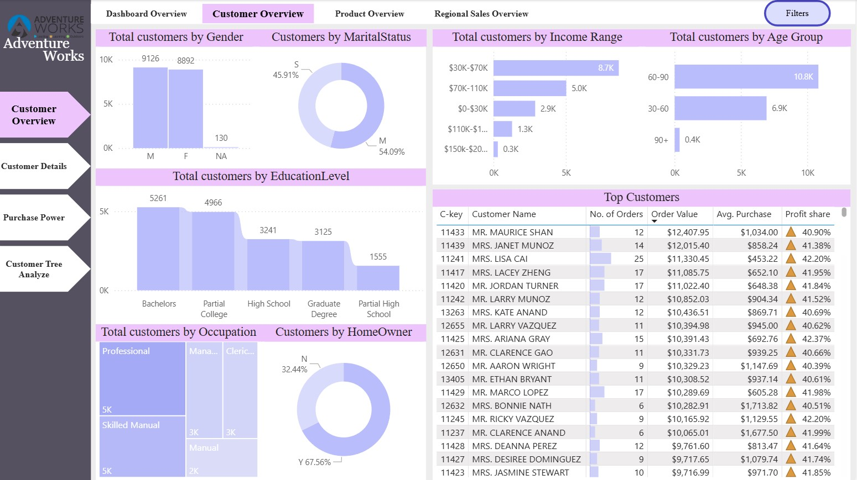
Dashboard: Customer Overview

Slide 20
Customer Overview: Understanding Our Audience
Demographic Breakdown
Socio-Economic Profile
Our customer base shows a near-even gender split, with males representing approximately 54% and females 46%. The largest age segment falls within the 60–90 bracket, followed by the 30–60 age group, indicating a mature customer profile. We also observe a slightly higher proportion of married customers.
A majority of our customers report an income range of $30K–$70K. Educationally, customers with Bachelor's degrees and those with Partial College education dominate our segments. In terms of occupation, Professionals and Skilled Manual workers lead, aligning with our product offerings and market positioning.
This detailed customer segmentation highlights that our core audience comprises older, mid-income professionals, providing a solid foundation for targeted marketing and product development strategies.

Slide 21

Customer Lifetime Value & Targeting Opportunities
Business Interpretation: Strategic Focus
Older, mid-income customers form the backbone of our revenue and profit.
Our premium pricing strategy resonates well with these loyal customers.
Significant opportunity for targeted loyalty programs to further engage and retain our most valuable segments.
Understanding their needs can drive new product development and service enhancements.
High-Value Customer Contributions
Our analysis of top customers reveals that a small segment of highly engaged, repeat buyers contributes over 40% of our total profit share. This significant contribution underscores the importance of fostering strong customer relationships and leveraging loyalty programs to maximize their lifetime value.
Indicates strong customer lifetime value (CLV) among top segments.
Opportunity for tailored loyalty programs and exclusive offers.
By focusing on these high-value customers, Adventure Works can cultivate deeper relationships and ensure sustainable growth.

Slide 22
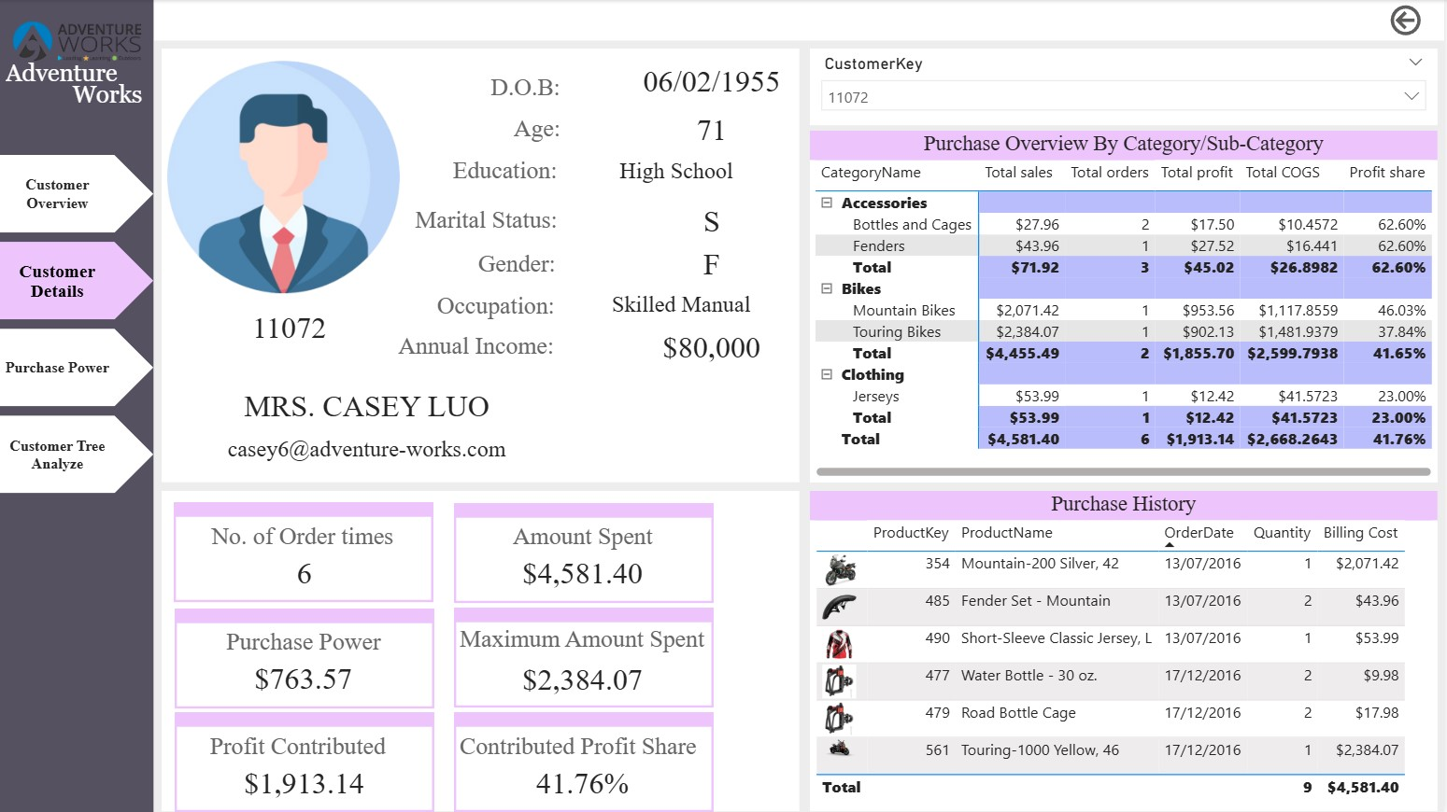
Dashboard: Customer Details

Slide 23
Customer 360° View: Individual Purchase Behavior
Detailed Purchase History
Product Preference & Cross-Sell
Strategic Implications
A deep dive into individual customer behavior, for instance, shows a customer with 6 orders placed, a total spend of $4,581, and a profit contribution of $1,913 (equating to a 41.76% profit share). This granular view allows for precise understanding of customer value.
Customers often make high-value purchases in Bikes, with Accessories and Clothing frequently acting as complementary add-ons. This pattern highlights a clear anchor product strategy. Repeat purchases consistently increase overall profitability, reinforcing the value of customer retention.
Bikes serve as anchor products, driving initial high-value engagement. Actively cross-selling accessories and clothing can significantly increase profit margins. These insights are invaluable for refining our CRM strategies and implementing personalized marketing campaigns.
By understanding individual customer journeys, Adventure Works can optimize product recommendations and enhance customer satisfaction, ultimately boosting repeat business and profitability.

Slide 24
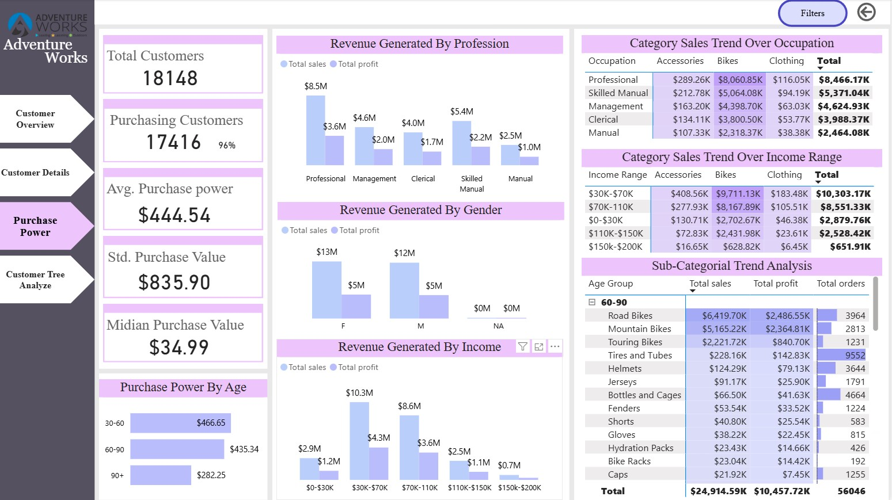
Dashboard: Customer Purchase Power

Slide 25






Purchase Power: Spending Capacity & Behavior
96%
$444
$835
Purchasing Customers
Average Purchase Value
Standard Purchase Value
A high percentage of our total customer base actively makes purchases, indicating strong product appeal and conversion rates among engaged users.
Our average purchase value reflects the typical spend per transaction across our customer base, providing a benchmark for sales performance.
The standard purchase value (median value is $35) indicates a skewed distribution, suggesting that a few high-value transactions significantly influence the average.
Professionals Drive Revenue
Mid-Income Influence
Female Profit Outperformance
The Professional occupation segment contributes the highest revenue and profit, underscoring their importance for premium product targeting.
Customers in the $30K–$70K income range are our largest revenue contributors, highlighting the effectiveness of targeting this demographic.
Interestingly, female customers slightly outperform males in profit contribution, suggesting nuanced purchasing behaviors worthy of further investigation.
This analysis reveals an uneven spending landscape, where a few high-value buyers drive significant revenue. Tailoring strategies to these segments can yield substantial returns.

Slide 26
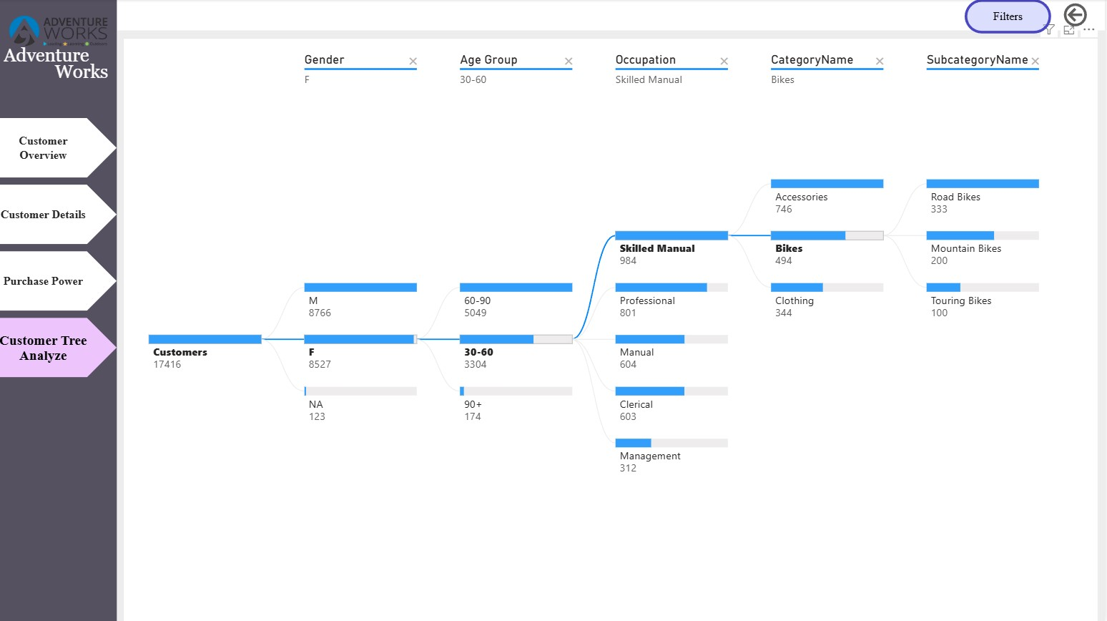
Dashboard: Customer Tree Analyze

Slide 27

Customer Tree Analysis: Mapping Profitable Journeys
Product Focus
Category → Sub-category highlighting bike dominance
Demographic Paths
Gender → Age → Occupation shaping preferences
Core Customer
Primary buyer targeting bike purchases
The Customer Tree Analysis visually charts the hierarchical flow of our customer base, segmenting them from broad demographics down to specific product purchases. This visualization helps us understand the most profitable customer journeys, enabling highly targeted marketing campaigns.
The path from Skilled Manual workers (age 30–60) consistently emerges as a strong and profitable segment.
Bikes dominate the final purchase nodes, confirming their role as the primary driver of high-value transactions.
Accessories frequently follow bike purchases, indicating successful cross-selling opportunities.
This analysis is ideal for identifying the most profitable customer journeys and optimizing our sales funnel for maximum conversion and value.
By understanding these customer journeys, Adventure Works can refine campaign targeting, improve personalization, and enhance the overall customer experience.

Slide 28
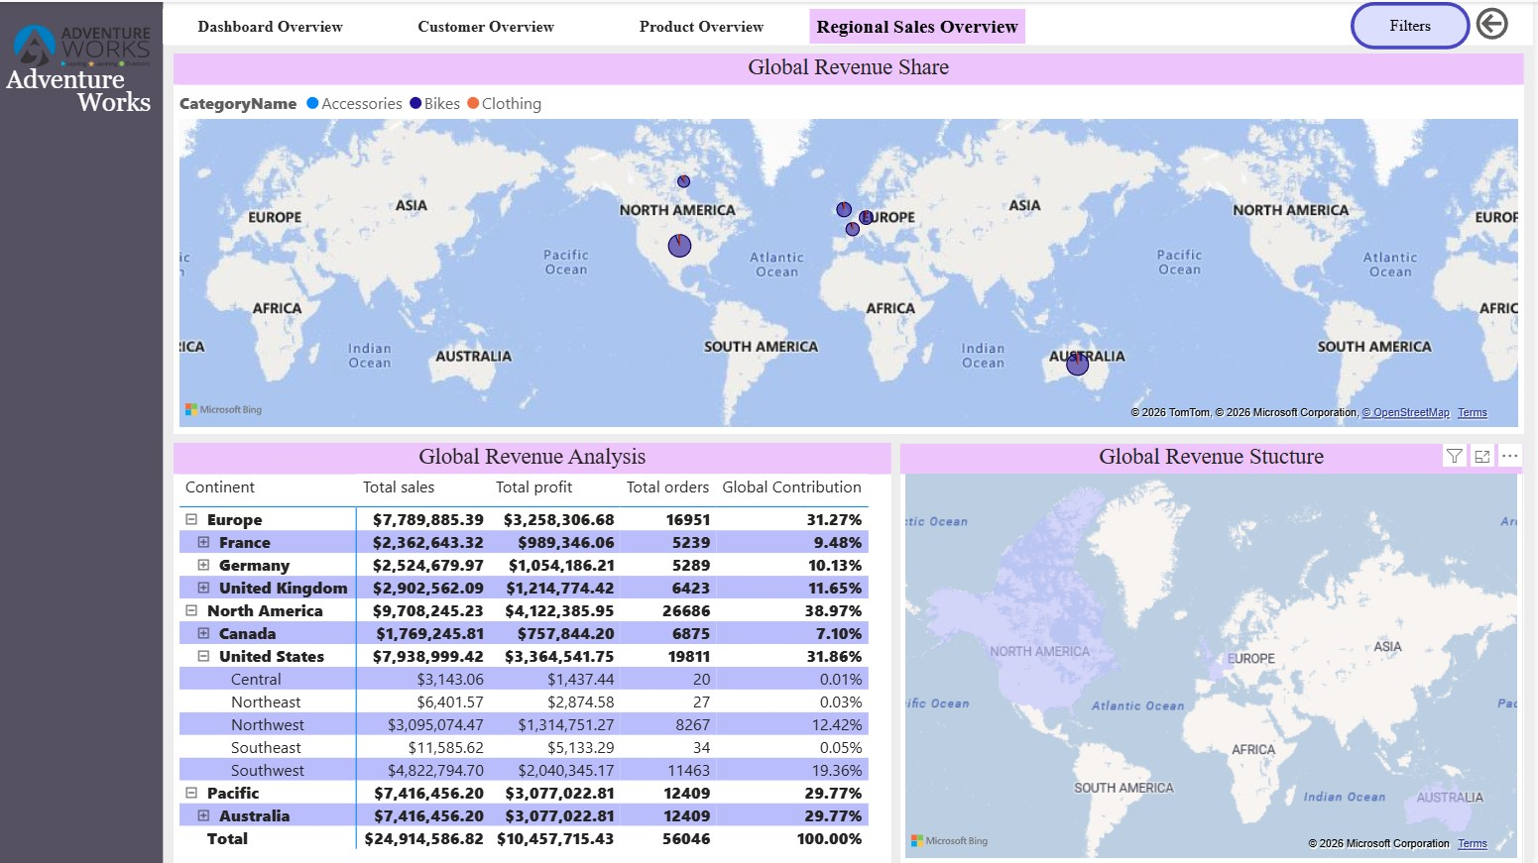
Dashboard: Regional Sales Overview

Slide 29
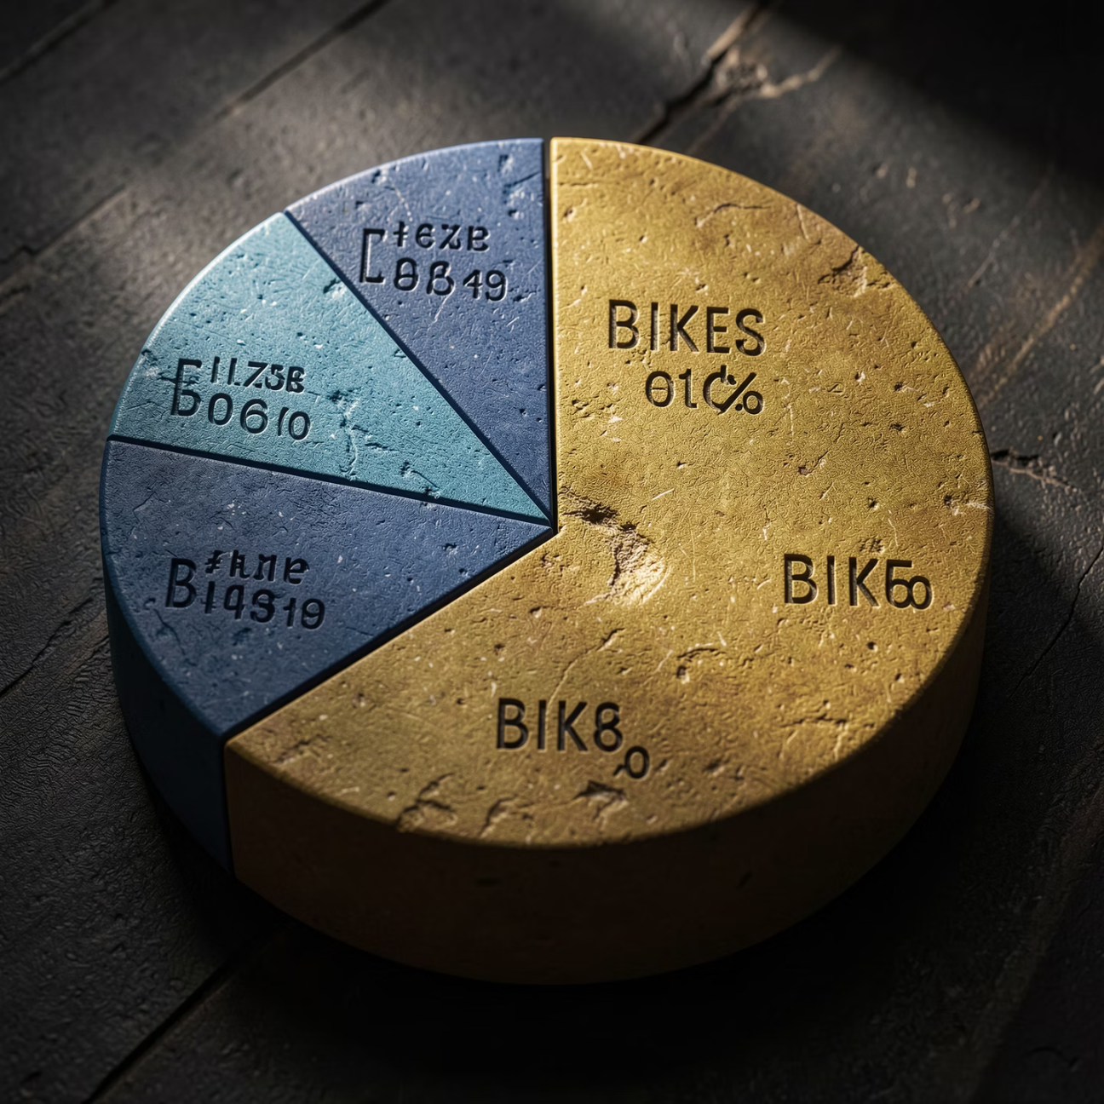

Product & Geographic Performance Highlights
Category & Product Dominance
Global Footprint & Key Markets
An in-depth look at our product portfolio reveals that Bikes are the undeniable leaders in profit contribution, forming the core growth engine for Adventure Works. Within this category, specific Mountain Bike variants contribute the highest order value, demonstrating their critical role in our product strategy and revenue generation.
Geographically, the United States stands as our top country for revenue, followed closely by Australia, the UK, and Germany. This distribution signifies that Europe and North America are major revenue drivers, underscoring the importance of these regions for sustained growth and market focus.
These insights underscore our core strengths: a dominant product category in Bikes and strong performance in established global markets, offering clear directions for future investment and expansion.

Slide 30

Key Trends & Insights
Revenue Seasonality: Peaks consistently around May–June, with a dip in July and strong recovery by
December.
Quarterly Performance: Q2 is our strongest quarter, while Q3 shows the weakest performance, signaling
clear seasonal patterns for demand planning.
Profit Stability: Profit trends closely mirror revenue, confirming a stable cost structure across fluctuations.
Product Dominance: Bikes are the primary profit drivers, with mountain bike variants contributing the
highest order value.
Geographic Performance
Our global footprint shows significant concentration in key regions:
Top Markets: The United States leads in revenue, followed by Australia, the
UK, and Germany.
Growth Engines: Europe and North America are major contributors to
overall revenue.

Slide 31
Adventure Works: Key Conclusions & Strategic Recommendations
01
02
03
Strong Financial Health
Bikes: The Core Driver
Targeted Customer Base
Adventure Works boasts robust overall profitability, with a healthy ~42% profit margin, affirming our effective business model and cost management.
Bikes are unequivocally the strategic product category, driving the majority of our revenue and profit. Continued innovation and focus in this area are critical.
Our primary customers are identified as older, professional, mid-income individuals. Customizing marketing and product development to this segment will yield significant returns.
04
05
Seasonal Preparedness
Balanced Global Footprint
Clear seasonality in revenue, with Q2 being strongest and Q3 weakest, necessitates proactive demand planning and promotional strategies.
While our global presence is balanced across continents, there is a distinct market concentration risk in the US, alongside significant growth potential in Australia and Europe.
Strategic Recommendations for Continued Growth
Invest in Bike Innovation: Further enhance our leading product category to maintain market dominance.
Improve Accessories Quality: Address return volumes in accessories to boost margins and customer satisfaction.
Launch Loyalty Programs: Cultivate high-value customers with tailored programs to increase retention and lifetime value.
Target Growth in Australia & Europe: Capitalize on strong regional performance and diversify market presence to mitigate US concentration risks.

